Slide 1
Exception Handling in JAVA

Slide 2
Exception Handling
An Exception is an unwanted event that interrupts the normal flow of the program.
• Errors are generated while writing a programming code.
• So these errors are displayed at compile time.
• Some of these errors do not show up at compile time but interrupts the normal flow of execution at run time.
• These errors are known as Exceptions in programming.
All exception and errors types are sub classes of class Throwable

Slide 3
Difference between Error and Exception
Exceptions in JAVA | Errors in JAVA
Occurs at compile time or run time | Occurs at runtime
Possible to recover when exception occurs | Impossible to recpover when error occurs

Slide 4
Difference between Error and Exception
Let us discuss the most important part which is the differences between Error and Exception that is as follows:
Error: An Error indicates a serious problem that a reasonable application should not try to catch.
Exception: Exception indicates conditions that a reasonable application might try to catch.

Slide 5
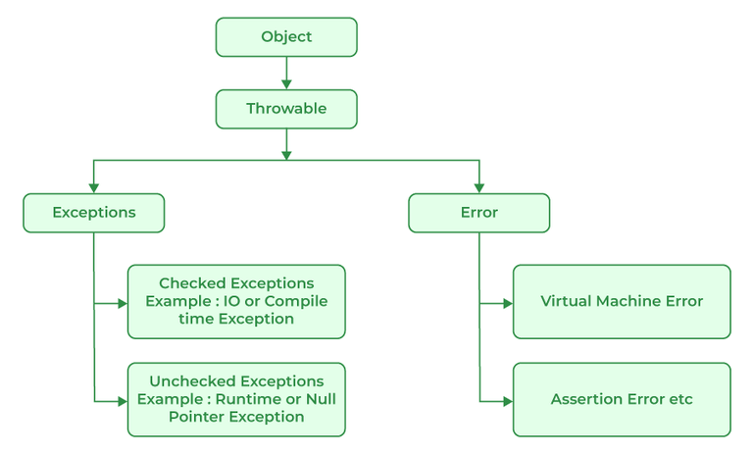
Exception Hierarchy
All exception and error types are subclasses of the class Throwable, which is the base class of the hierarchy. One branch is headed by Exception.

Slide 6
Types of Exceptions
Java defines several types of exceptions that relate to its various class libraries. Java also allows users to define their own exceptions.
Exceptions can be categorized in two ways:
1. Built-in Exceptions
Checked Exception - Checked exceptions are called compile-time exceptions because these exceptions are checked at compile-time by the compiler.
Unchecked Exception - The unchecked exceptions are just opposite to the checked exceptions. The compiler will not check these exceptions at compile time. In simple words, if a program throws an unchecked exception, and even if we didn’t handle or declare it, the program would not give a compilation error.

Slide 7
2. User-Defined Exceptions
Sometimes, the built-in exceptions in Java are not able to describe a certain situation. In such cases, users can also create exceptions, which are called ‘user-defined Exceptions’.

Slide 8
The advantages of Exception Handling in Java are as follows:
Provision to Complete Program Execution
Easy Identification of Program Code and Error-Handling Code
Propagation of Errors
Meaningful Error Reporting
Identifying Error Types

